Slide 1
Artificial Intelligence & Machine Learning
Presented by
TV Manoj 4S018EC107
Under the Guidance of
Internal Guide External Guide
Aldrin Claytus Vaz Vedanth Shenoy
Assistant Professor CTO

Slide 2
Contents
Company Profile
Introduction
Tasks Performed
Project Carried out
Results
Outcomes

Slide 3

Company Profile
ZEPHYR TECHNOLOGIES is a software company delivering high quality, cost effective, reliable result-oriented web and e-commerce solutions.

Slide 4
Company Profile contd
Artificial Intelligence and Machine Learning
● Web development
● App development
● Digital Marketing

Slide 5
Introduction
Machine Learning is an Artificial Intelligence technique or subset based on the premise that computers may be given access to data as well as the ability to learn from it.
Machine learning is an application of artificial intelligence (AI) that allows systems to learn.

Slide 6
Introduction contd
Machine Learning has the following characteristics:
• It is computationally expensive and requires a huge amount of training data.

Slide 7
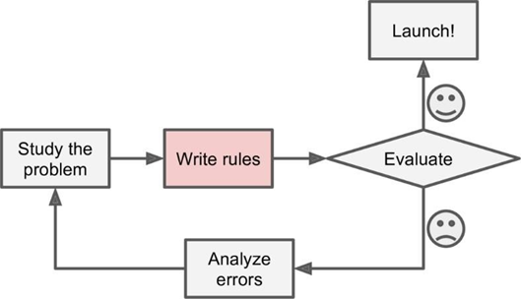
Task Performed
Traditional approach

Slide 8
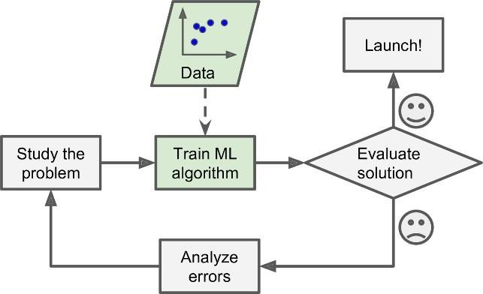
Task Performed Contd
Machine Learning Approach

Slide 9
Task Performed contd
In First week of the Internship we were taught :
Basic Mathematics.
Installing Python.
Some basics of python like conditional statements and loops.

Slide 10
Task Performed Contd
Machine Learning Techniques
Supervised Learning
Unsupervised Learning

Slide 11
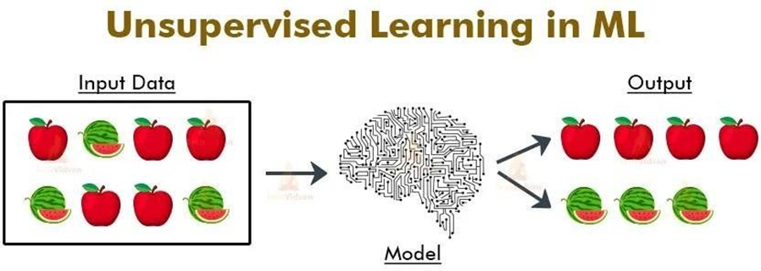
Task Performed Contd
Unsupervised Learning

Slide 12
Task Performed contd
Supervised Learning

Slide 13
Task Performed contd
Linear Regression
Decision Tree Regression
Random Forest Regression
Logistic Regression
Support Vector Machines

Slide 14
Task Performed contd
In Second week of the Internship we were taught :
Analysis and manipulation of real time, popular datasets like Zomato and Titanic.
Understanding of dataframes such as numpy and pandas.

Slide 15
Task Performed contd
In Third week of the Internship we were taught :
Data Pre-Processing.
Difference between AI and ML.
Problems Related to datasets.

Slide 16
PROJECT CARRIED OUT - Prajwal
The project I decided to go with is “Heart Stroke Predictor”.
Stroke happens when the brain's blood vessels become narrowed or blocked, causing severely reduced blood flow.
The goal here is to build a model which is able to predict the occurrence of a stroke based on the data the person has given.
26/07/2022
Department of ECE, SJEC, Vamanjoor
16

Slide 17
PROJECT CARRIED OUT (Contd.)
A CSV file consisting of the personal and health related data of people was used as the dataset to train the model.
Google Colab notebook was used to build the project.
26/07/2022
Department of ECE, SJEC, Vamanjoor
17

Slide 18
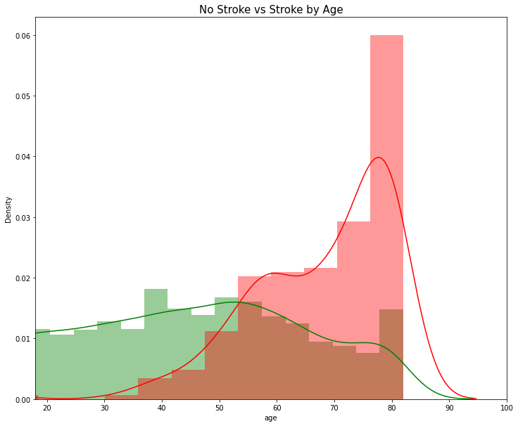
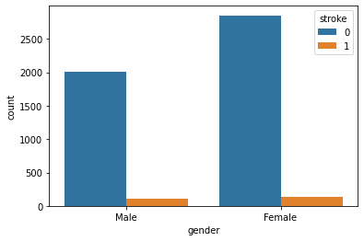
PROJECT CARRIED OUT (Contd.)
Some notable observations from the project:
26/07/2022
Department of ECE, SJEC, Vamanjoor
18

Slide 19
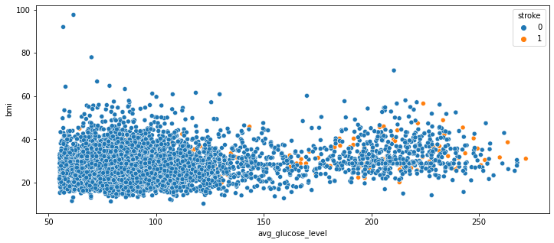
PROJECT CARRIED OUT (Contd.)
Some notable observations from the project:
26/07/2022
Department of ECE, SJEC, Vamanjoor
19

Slide 20
RESULTS
Machine learning algorithms such as Random Forest Classifier, KNN, Logistic Regressor and SVR are used to predict the outcome of stroke.
True positive and false positive rates are being determined.
Random Forest Regressor is found to be the most accurate and efficient.
26/07/2022
Department of ECE, SJEC, Vamanjoor
20

Slide 21
RESULTS (Contd.)
The accuracy is as follows :
Logistic regression-79.06 %
Support vector machine 88.29 %
KNN-91.03 %
Random forest-95.97%
26/07/2022
Department of ECE, SJEC, Vamanjoor
21

Slide 22
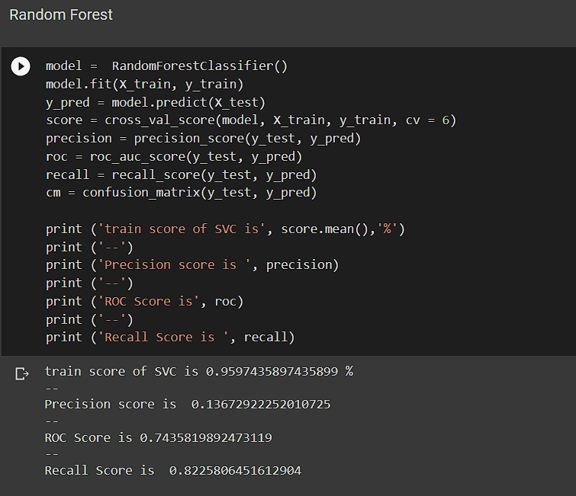
RESULTS (Contd.)
26/07/2022
Department of ECE, SJEC, Vamanjoor
22

Slide 23
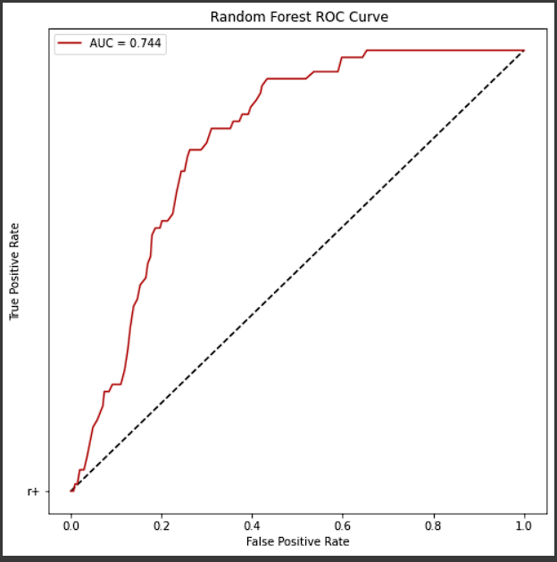
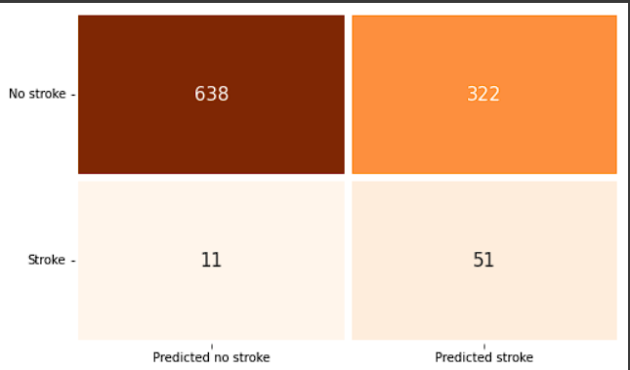
RESULTS (Contd.)
26/07/2022
Department of ECE, SJEC, Vamanjoor
23

Slide 24
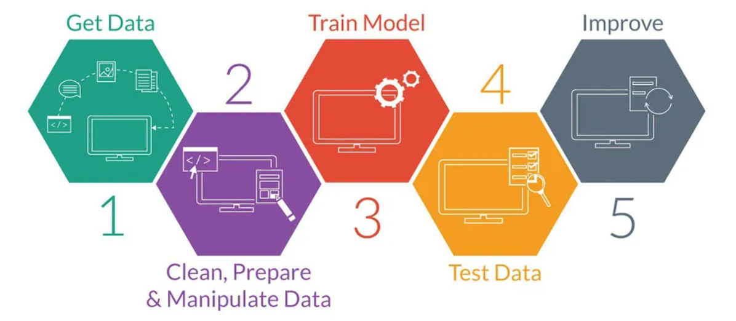
Project Carried out - Samarth
Car Price Estimation
Department of ECE, SJEC, Vamanjoor

Slide 25
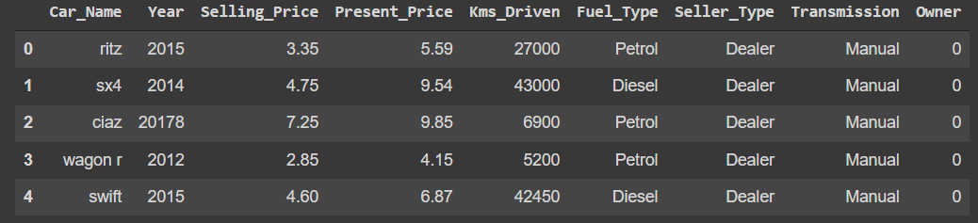
Project Carried out
Used Car Price Estimation
Dataset
Department of ECE, SJEC, Vamanjoor

Slide 26
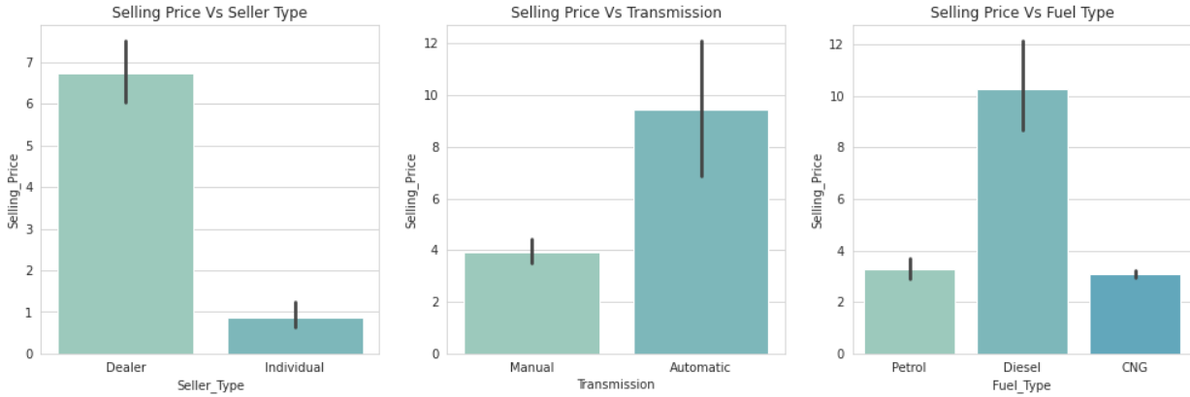
Project Carried out
Data Exploration & Visualization
Department of ECE, SJEC, Vamanjoor

Slide 27
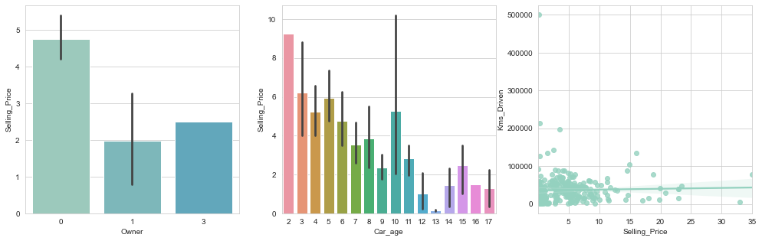
Data Exploration & Visualization

Slide 28
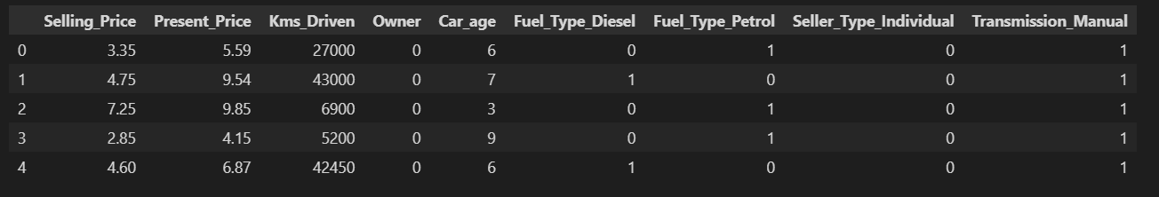
Project Carried out
Dealing With Categorical Variables
Department of ECE, SJEC, Vamanjoor

Slide 29
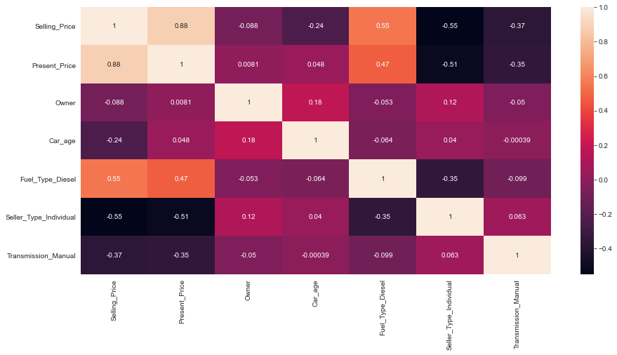
Project Carried out
Correlation
Department of ECE, SJEC, Vamanjoor

Slide 30
Project Carried out
Algorithms Used
Linear Regression.
Random Forest Regression.
Department of ECE, SJEC, Vamanjoor

Slide 31
Results
R-Squared Value
Model | R-Squared Value
Linear Regression | 84.07%
Random Forest Regression | 92.084%
Department of ECE, SJEC, Vamanjoor

Slide 32
Project Carried out - Sanidhya
A loan prediction dataset was imported.
The two most pressing issue in the banking sector is 1) How risky is the borrower ? 2) should it be lent to borrower at given risk?
Department of ECE, SJEC, Vamanjoor

Slide 33
Project Carried out
Decision Trees
This is a supervised machine learning algorithm mostly used for classification problems. All features should be discretized in this model, so that the population can be split into two or more homogeneous sets or subsets. This model uses a different algorithm to split a node into two or more sub-nodes. With the creation of more sub-nodes, homogeneity and purity of the nodes increases with respect to the dependent variable
Department of ECE, SJEC, Vamanjoor

Slide 34
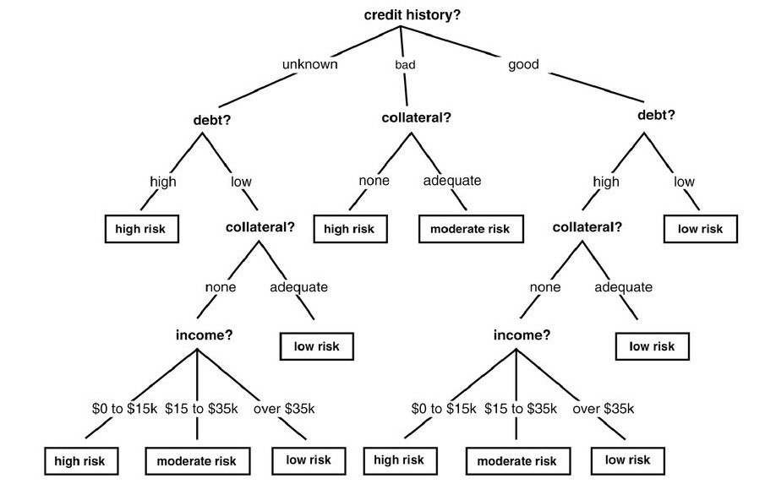
Project Carried out
LOAN PREDICTION
Department of ECE, SJEC, Vamanjoor

Slide 35
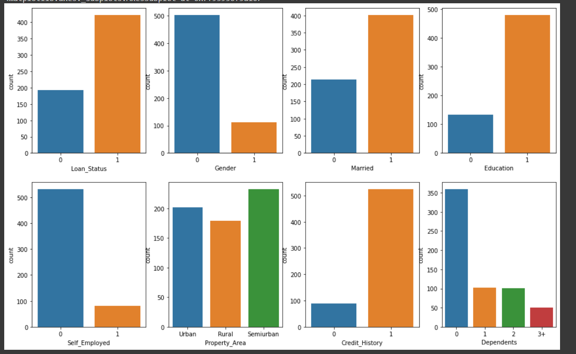
Results….
Department of ECE, SJEC, Vamanjoor

Slide 36
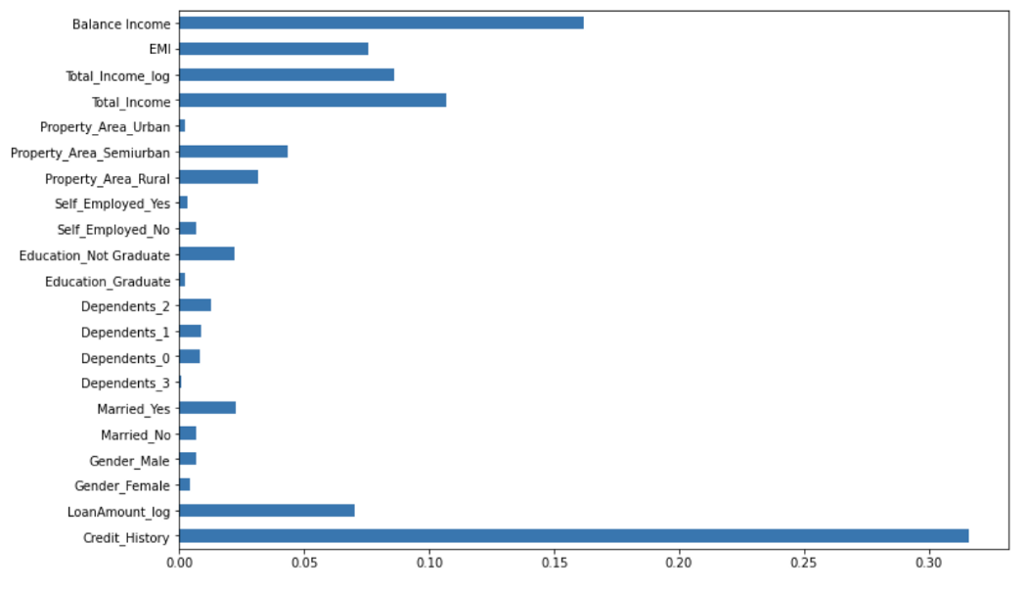
Results
Department of ECE, SJEC, Vamanjoor

Slide 37
Results
model = DecisionTreeClassifier() predictor_var = ['Credit_History','Gender','Married','Education'] classification_model(model, df,predictor_var,outcome_var)OUT: Accuracy : 80.945%
Department of ECE, SJEC, Vamanjoor

Slide 38
Project Carried out - Sherwin
Drinking water potability
Why this project ?
Essential To Health
Basic Human Right
Component Of Effective Policy For Health Protection
Department of ECE, SJEC, Vamanjoor

Slide 39
Algorithm Used
Random Forest Classifier
K-Nearest Neighbor
Support Vector Machines
Logistic Regression

Slide 40
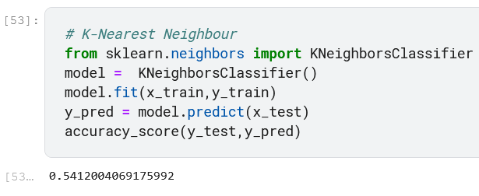
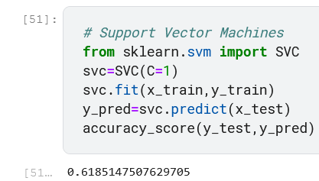
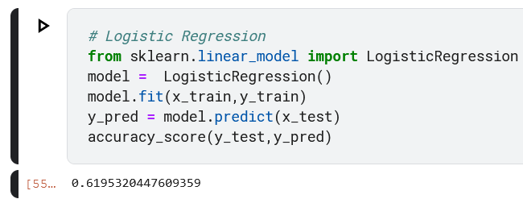
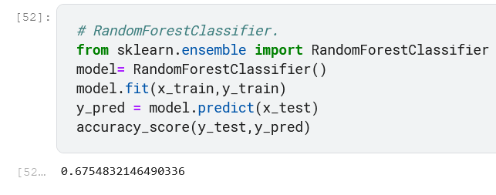
Results
Department of ECE, SJEC, Vamanjoor

Slide 41
PROJECT CARRIED OUT - Shravya
The project is “Water Quality Prediction”.
Implement a water quality prediction using machine learning techniques.
the model predicts whether the water is safe to drink or not using parameters like Ph value, conductivity, hardness, etc.
The water_potability.csv file contains water quality metrics for 3276 different water bodies.
Google Colab notebook was used to build the project.
26/07 /2022
Department of ECE, SJEC, Vamanjoor
41

Slide 42
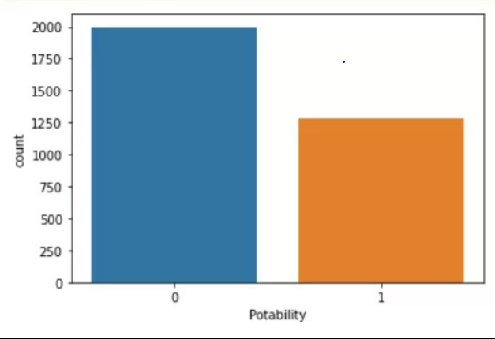
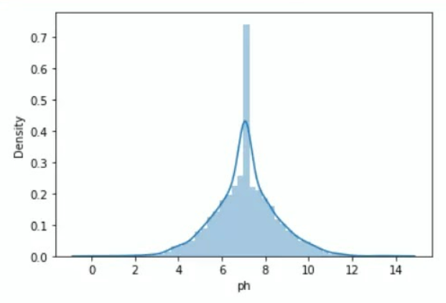
PROJECT CARRIED OUT (Contd.)
Some notable observations from the project:
Visualize Potability
Visualize the pH
26/07/2022
Department of ECE, SJEC, Vamanjoor
42

Slide 43
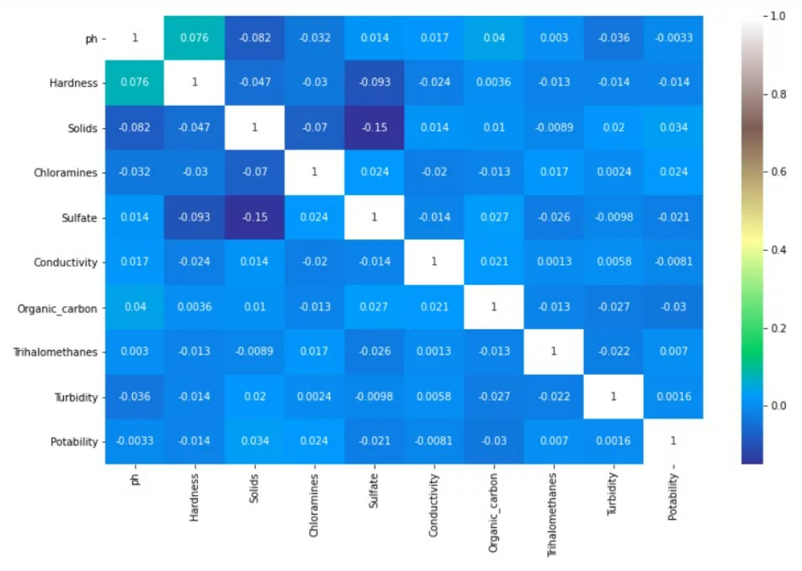
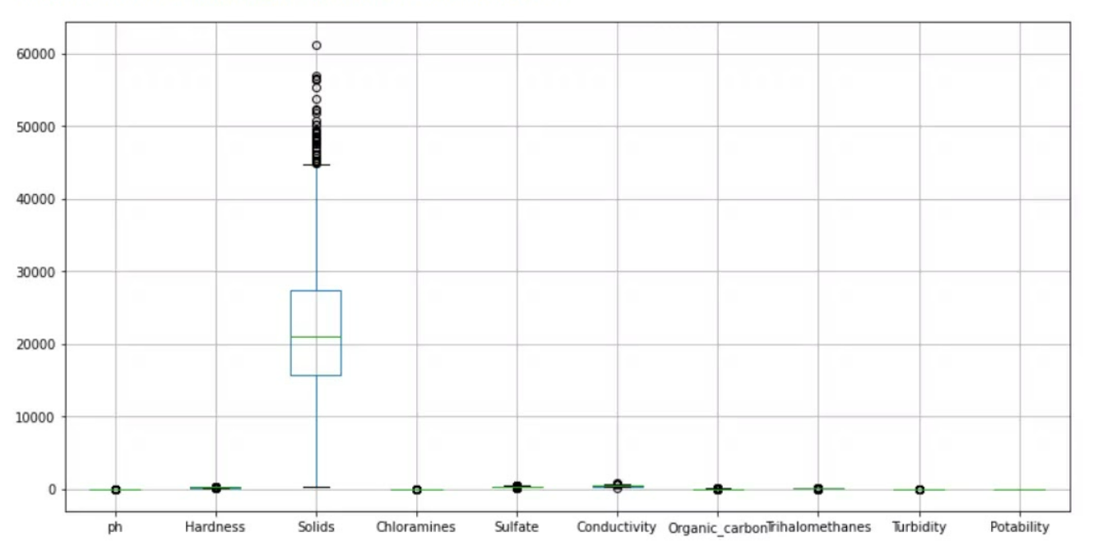
PROJECT CARRIED OUT (Contd.)
Some notable observations from the project:
Heat Map
Visualize the outlier using a boxplot function
26/07/2022
Department of ECE, SJEC, Vamanjoor
43

Slide 44
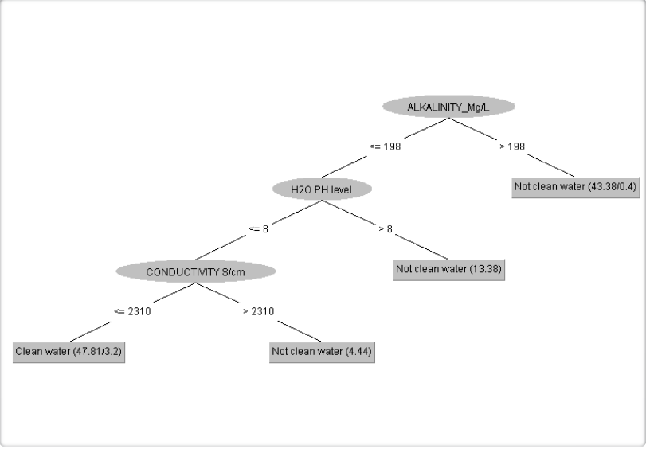
PROJECT CARRIED OUT (Contd.)
Some notable observations from the project:
26/07/2022
Department of ECE, SJEC, Vamanjoor
44

Slide 45
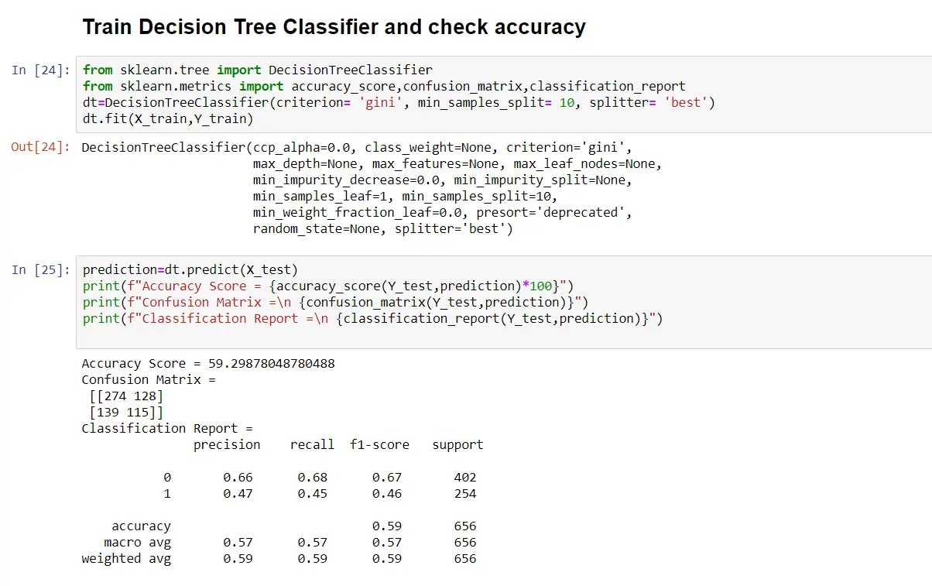
RESULTS
evaluate the model using the accuracy score, confusion matrix and classification report
test the model on a custom data set
26/07/2022
Department of ECE, SJEC, Vamanjoor
45

Slide 46
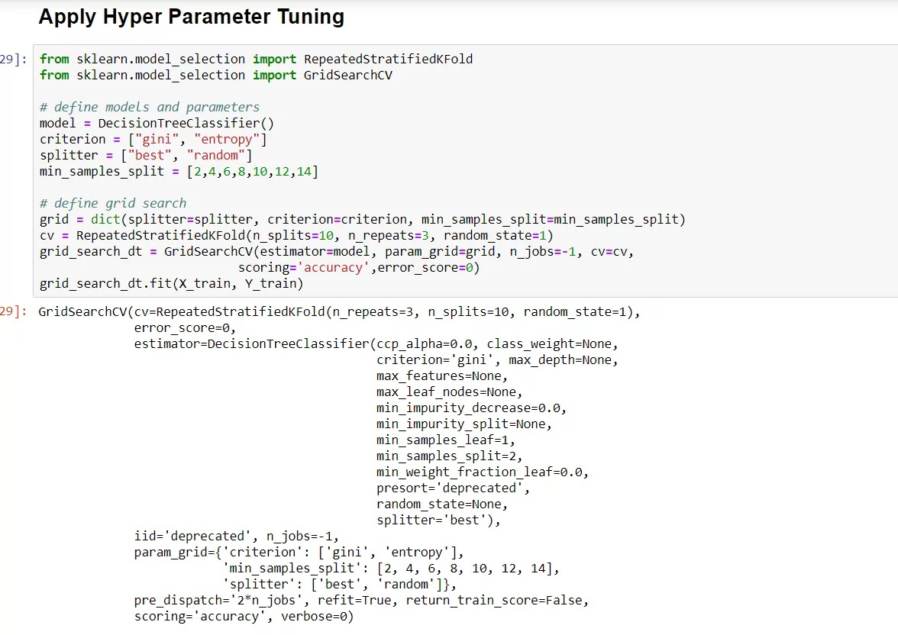
RESULTS (Contd.)
26/07/2022
Department of ECE, SJEC, Vamanjoor
46

Slide 47
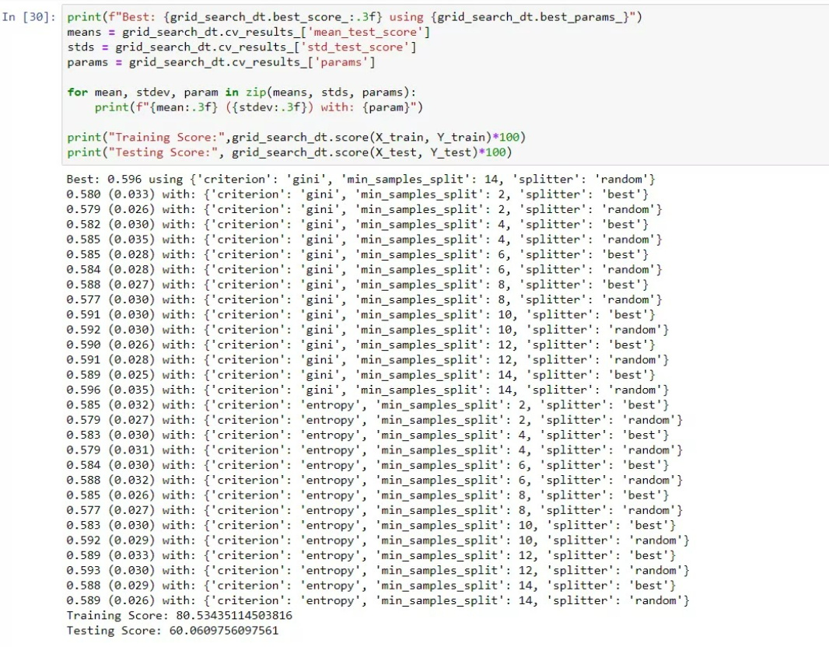
RESULTS (Contd.)
26/07/2022
Department of ECE, SJEC, Vamanjoor
47

Slide 48

Project Carried out - Shreesha
What is Alzheimer Disease?
Department of ECE, SJEC, Vamanjoor

Slide 49
Project Carried out
Early Detection of Alzheimer’s Disease
Dataset Used
Mini Mental State Examination Education
Clinical Dimentia Rating Normalize whole Brain Volume Atlas Scaling Factor
Department of ECE, SJEC, Vamanjoor

Slide 50
Project Carried out
Algorithms used
Logistic Regression
Support Vector Machine
Decision Tree
Random Forest
AdaBoost
Department of ECE, SJEC, Vamanjoor

Slide 51
Results
 | Model | Accuracy | Recall | AUC
0 | Logistic Regression(w/ imputation) | 0.789474 | 0.75 | 0.791667
1 | Logistic Regression (w/ dropna) | 0.750000 | 0.70 | 0.700000
2 | SVM | 0.815789 | 0.70 | 0.822222
3 | Decision Tree | 0.815789 | 0.65 | 0.825000
4 | Random Forest | 0.842105 | 0.80 | 0.84444
5 | AdaBoost | 0.842105 | 0.65 | 0.825000
Department of ECE, SJEC, Vamanjoor

Slide 52
PROJECT CARRIED OUT - Shreyas
The project is “Life Expectancy Prediction”.
The term “life expectancy” refers to the number of years a person can expect to live.
By definition, life expectancy is based on an estimate of the average age that members of a particular population group will be, when they die.
26/07 /2022
Department of ECE, SJEC, Vamanjoor
52

Slide 53
PROJECT CARRIED OUT (Contd.)
The goal here is to build a model which is able to predict the life expectancy in a particular country.
The dataset related to life expectancy, health factors for 193 countries has been collected from the WHO data repository website and its corresponding economic data was collected from United Nation website.
Google Colab notebook was used to build the project.
29/12/2021
Department of ECE, SJEC, Vamanjoor
53

Slide 54
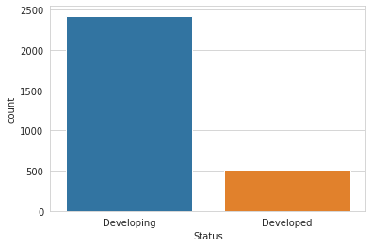
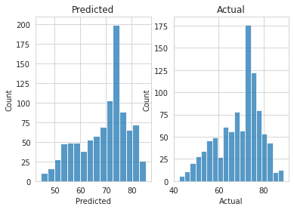
PROJECT CARRIED OUT (Contd.)
Some notable observations from the project:
Graphical EDA between developing and developed countries
Histogram plot of predicted and actual result
26/07/2022
Department of ECE, SJEC, Vamanjoor
54

Slide 55
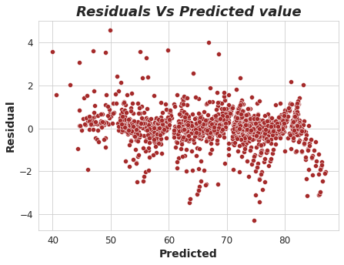
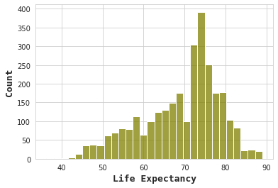
PROJECT CARRIED OUT (Contd.)
Some notable observations from the project:
Scatter plot of Residuals vs Predicted Value
Histogram plot of Life expectancy
26/07/2022
Department of ECE, SJEC, Vamanjoor
55

Slide 56
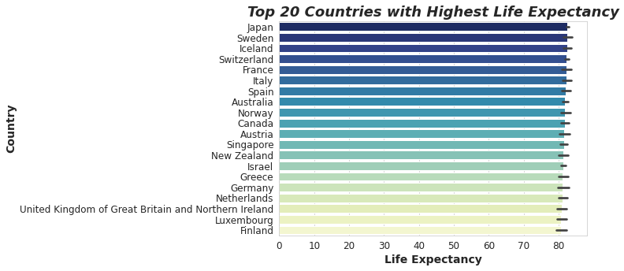
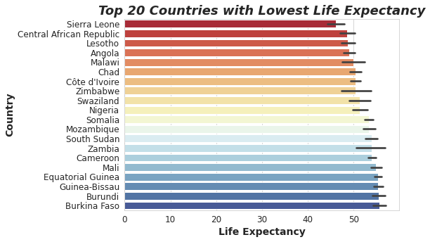
PROJECT CARRIED OUT (Contd.)
Some notable observations from the project:
26/07/2022
Department of ECE, SJEC, Vamanjoor

Slide 57
RESULTS
Algorithms used for life expectancy prediction
1. Random forest Regression
2. Ada Boost Regression
3. Gradient Regression
4. Decision Tree Regression
5. Linear Regression
6. Support Vector Machine
The Random forest Regression has an accuracy of 98.29%
The rest of the Algorithms has an accuracy in the range 88% - 97%.
26/07/2022
Department of ECE, SJEC, Vamanjoor
57

Slide 58
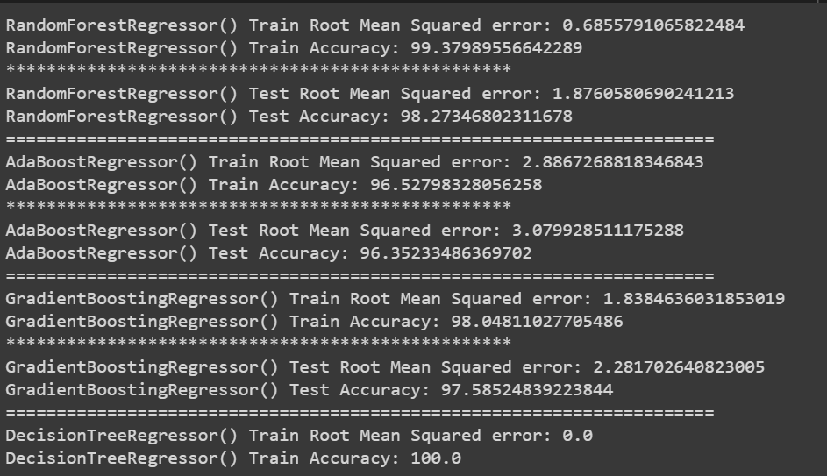
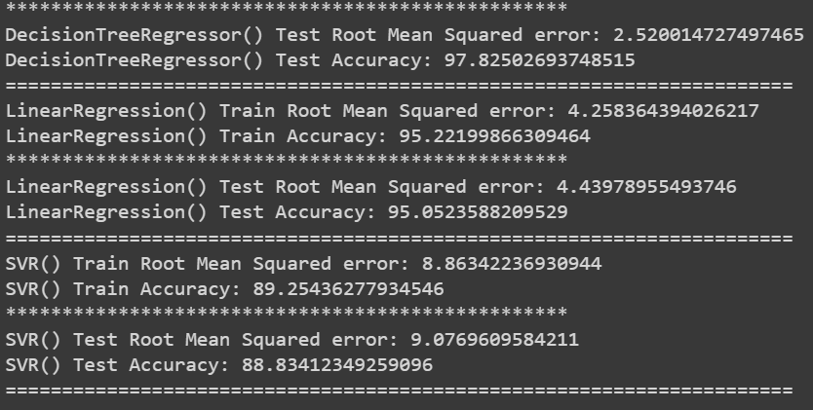
RESULTS (Contd.)
26/07/2022
Department of ECE, SJEC, Vamanjoor
58

Slide 59
PROJECT CARRIED OUT - suvira
The project carried out by me is “Gold Price Prediction”.
Price of gold depends on a myriad of interrelated variables, including inflation rates, currency fluctuation and political turmoil.
The goal here is to build a model which is able to predict the fluctuations in the price of gold based on the data the person has given.
26/07/2022
Department of ECE, SJEC, Vamanjoor
59

Slide 60
PROJECT CARRIED OUT (Contd.)
In this project, The dataset available on Kaggle is used. One can find various such sites to download from.
Kaggle notebook was used to build the project.
The data is in stored in structured csv file format.
26/07/2022
Department of ECE, SJEC, Vamanjoor
60

Slide 61
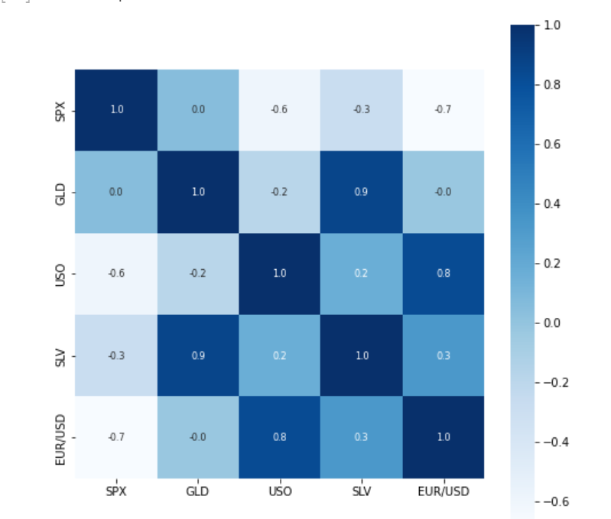
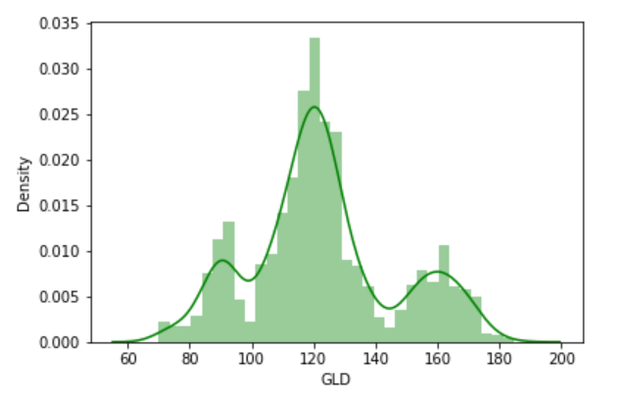
PROJECT CARRIED OUT (Contd.)
Some notable observations from the project:
26/07/2022
Department of ECE, SJEC, Vamanjoor
61

Slide 62
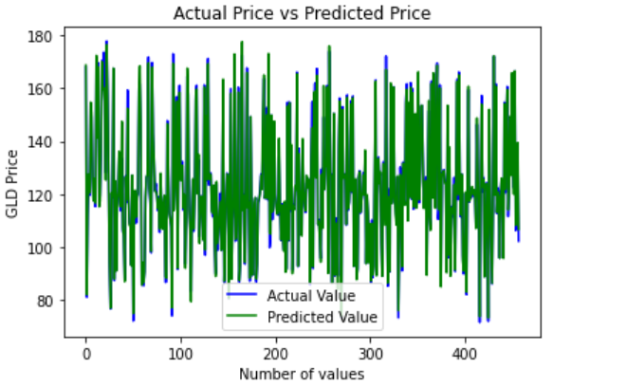
PROJECT CARRIED OUT (Contd.)
Some notable observations from the project:
26/07/2022
Department of ECE, SJEC, Vamanjoor
62

Slide 63
RESULTS
The Machine learning algorithm, Random Forest Regression is used to predict the fluctuations of Gold price.
Random Forest Regression is found to be 80% accurate in predicting the gold price.
26/07/2022
Department of ECE, SJEC, Vamanjoor
63

Slide 64
PROJECT CARRIED OUT - Swaroop
The project I decided to go with is “RAINFALL PREDICTION”.
Rainfall prediction is mainly concerned with the prediction of weather condition for a given environment.
Accurate prediction of weather condition is a difficult task since weather is nonlinear and dynamic process. That is, it varies from day to day and even from minute to minute.
27/12 /2021
Department of ECE, SJEC, Vamanjoor
64

Slide 65
PROJECT CARRIED OUT
(Contd.)
The easy of the prediction depends on the knowledge of previous weather conditions over large areas and over large period.
The critical information about the future weather is provided by the forecasting department.
27/12 /2021
Department of ECE, SJEC, Vamanjoor
65

Slide 66
PROJECT CARRIED OUT (Contd.)
A CSV file consisting of the 10 years of rainfall data from various weather stations was used as the dataset to train the model.
Google Colab notebook was used to build the project.
27/12/2021
Department of ECE, SJEC, Vamanjoor
66

Slide 67
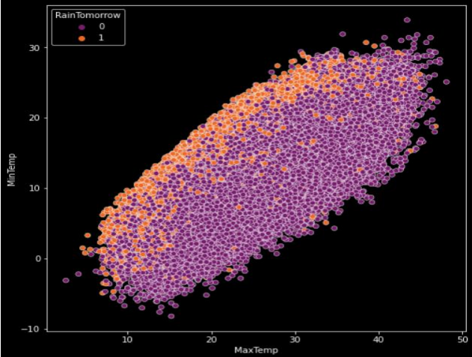
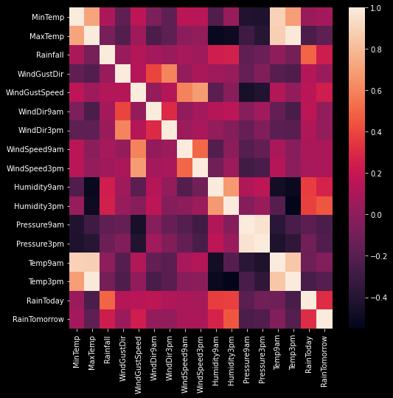
PROJECT CARRIED OUT (Contd.)
Some notable observations from the project:
27/12/2021
Department of ECE, SJEC, Vamanjoor
67

Slide 68
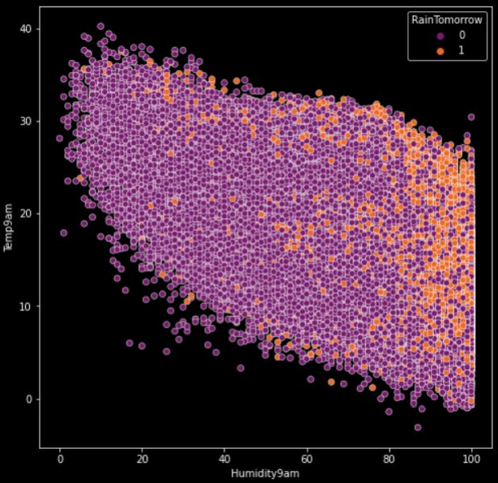
PROJECT CARRIED OUT (Contd.)
Some notable observations from the project:
27/12/2021
Department of ECE, SJEC, Vamanjoor
68

Slide 69
RESULTS
Machine learning algorithms such as Random Forest Classifier, Logistic Regression, decision tree, XGboost Classifier are used to predict the rainfall.
Random Forest Regressor is found to be the most accurate and efficient.
27/12/2021
Department of ECE, SJEC, Vamanjoor
69

Slide 70
RESULTS (Contd.)
The accuracy is as follows :
Decision tree – 78.68%
Logistic regression – 85.14%
XG Boost – 85.71%
Random forest classifier – 86.01%
27/12/2021
Department of ECE, SJEC, Vamanjoor
70

Slide 71
Project Carried Out - Manoj
The main challenge in today’s healthcare is provision of best quality services and effective accurate diagnosis.
Even if heart diseases are found as the prime source of death in the world in recent years, they are also the ones that can be controlled and managed effectively.

Slide 72
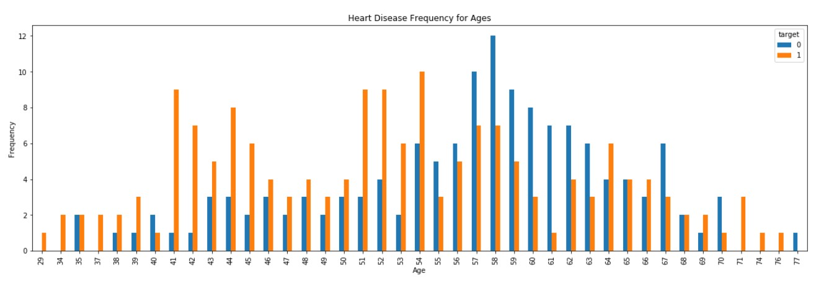
Project Carried Out (Contd.)

Slide 73
Results
Machine Learning algorithms such as random forest, KNN, Logistic Regression are used to predict Heart Disease.
KNN is found to be the most accurate and efficient.

Slide 74
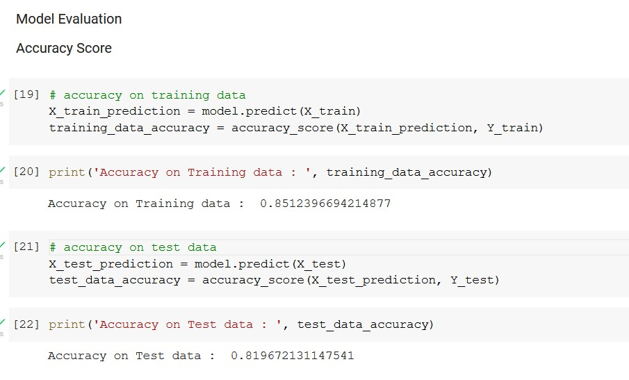
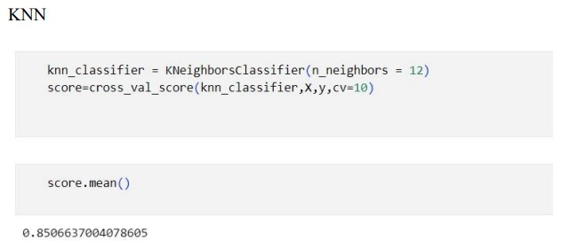
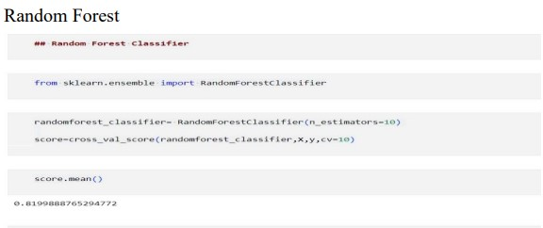
Results (Contd.)

Slide 75
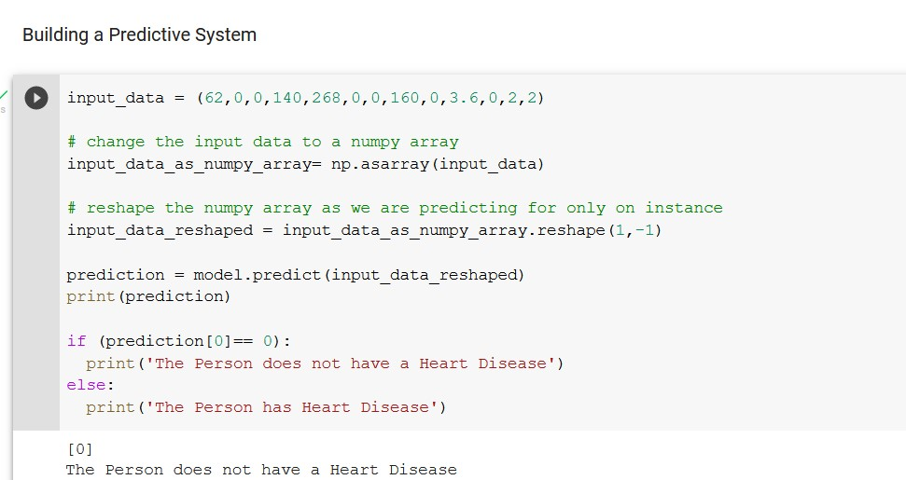
Results (Contd.)

Slide 76
Results (Contd.)
Accuracy is as follows:
Logistic Regression – 81.9%
KNN – 85%
Random Forest – 81.9%

Slide 77
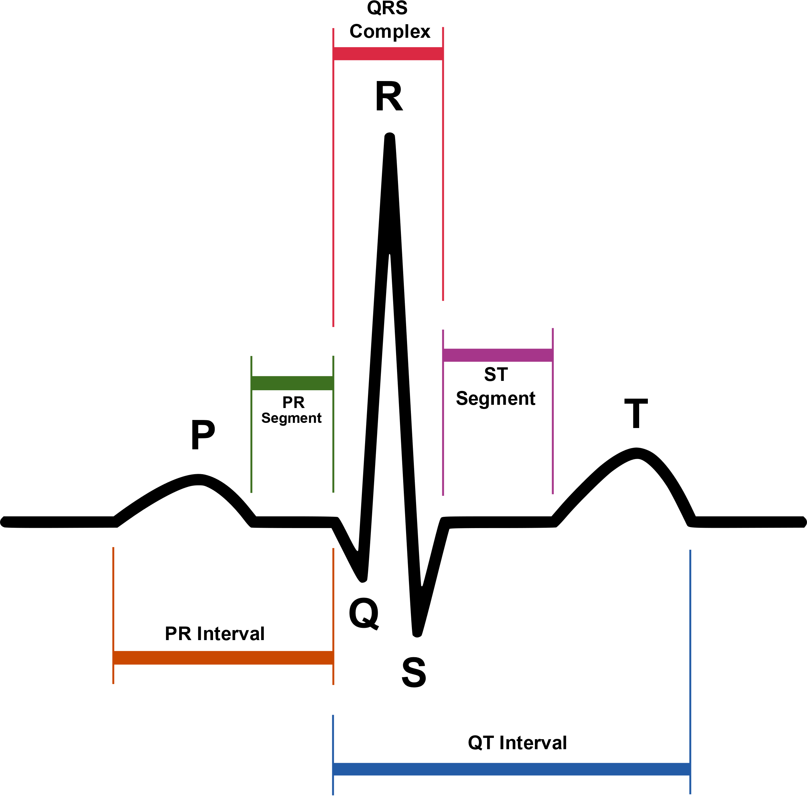
PROJECT CARRIED OUT - Vinutha
The project I decided to go with is “Heart disease Predictor”.
A healthy person’s heart beat is monitored through ECG.
29/12 /2021
Department of ECE, SJEC, Vamanjoor
77

Slide 78
PROJECT CARRIED OUT (Contd.)
The goal here is to build a model which is able to predict the occurrence of a diseased heart based on the data the person has given.
A CSV file consisting of the personal and health related data of people was used as the dataset to train the model.
Jupiter notebook was used to build the project.
29/12/2021
Department of ECE, SJEC, Vamanjoor
78

Slide 79

PROJECT CARRIED OUT (Contd.)
Some notable observations from the project:
29/12/2021
Department of ECE, SJEC, Vamanjoor
79

Slide 80
RESULTS (Contd.)
After training and testing the dataset we have got an accuracy of 85.12% .
So from this project we can conclude that , if the output is given as 0 then the person does not have heart disease
Else , if the result is 1 then the person has heart disease .
29/12/2021
Department of ECE, SJEC, Vamanjoor
80

Slide 81
Outcomes
The Key takeaways from this internship are :
Analyzing and learning to build AI and ML models that can be used for prediction, extraction, recognition, and so on.
Collection of information from different types of datasets.
Understanding and using various python libraries like Numpy, Pandas.

Slide 82
Thanking you for Your attention
Any Questions ?

